Slide 1
Planning for setting up Relief facilities for migrant population during COVID 19 spread using GIS based portal
The nation-wide lockdown from the 24th March, 2020 to curb the spread of COVID-19 has upended the lives of millions of migrant wage earners across Indian cities and towns
Aimed at addressing the hardships faced by migrant people during the lockdown, the GIS enabled portal has been built to provide information to decision makers and other interested organizations/individuals to plan for setting up relief centers and undertake relief measures
As an immediate and first version, it displays all the connecting national and state highways from migration hotspots like Delhi or Mumbai to the regional head quarters of various districts/blocks
It maps all the potential schools and health care facilities within a 2 km buffer area of the migration routes, which can be used as 'relief centers' for providing food, water, shelter, and basic health facilities and (possible) isolation measures could be set up.

Slide 2
Available Data
State, District, Sub-district and village map
Open Street Map/Google earth image at background
Parliament and Assembly constitution map
Road Network (NH,SH, District Road)
Health facilities (Hospital, Health centre etc)
School building (around 2km buffer of the road)
Covid 19 testing facility
Quarantine centres
Trained health candidate data (location and phone no) under Deen Dayal Upadhyaya Grameen Kaushalya Yojana

Slide 3
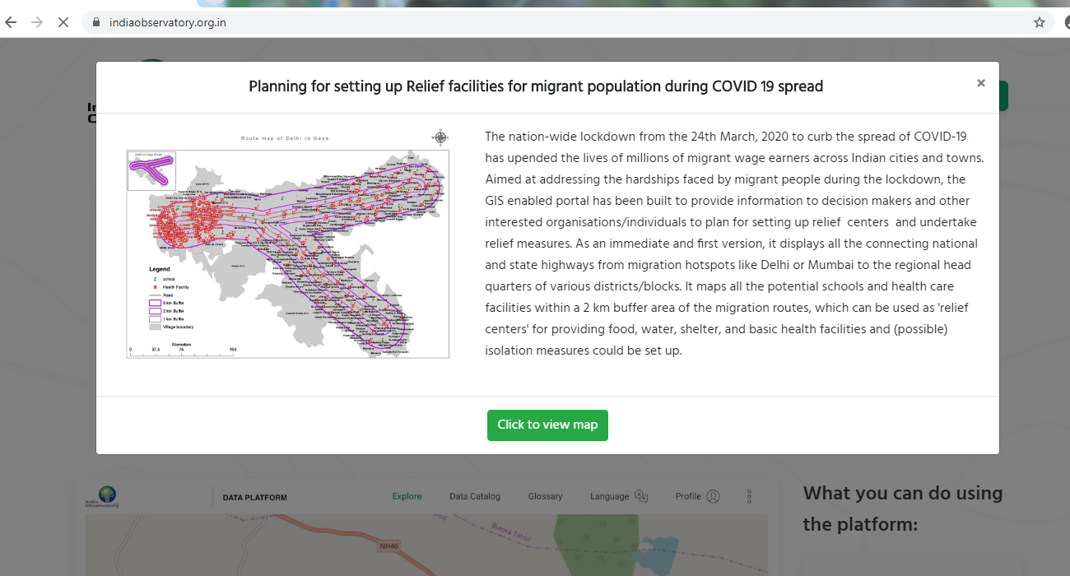
www.indiaobservatory.org.in
Click here to go to map page

Slide 4
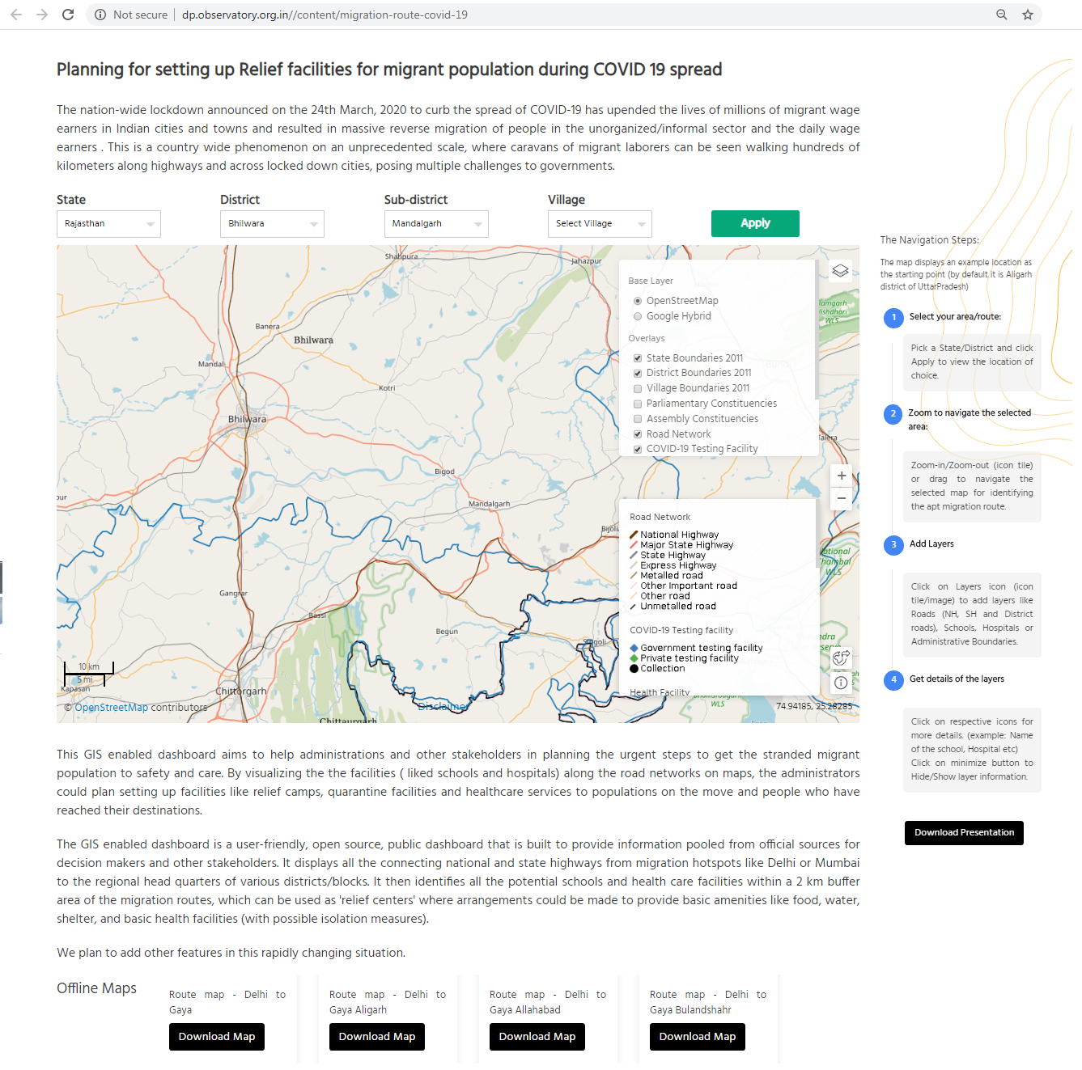

Slide 5
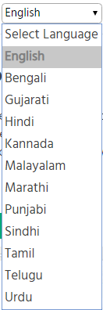
The portal is available
in 12 languages
Select you State-District-Block-Village to Click Apply to
go to your required location
+ or – button helps to
zoom in or zoom out

Slide 6
Select and tick the layer of Road,
Hospital or /and School and others from
this box to display on map

Slide 7
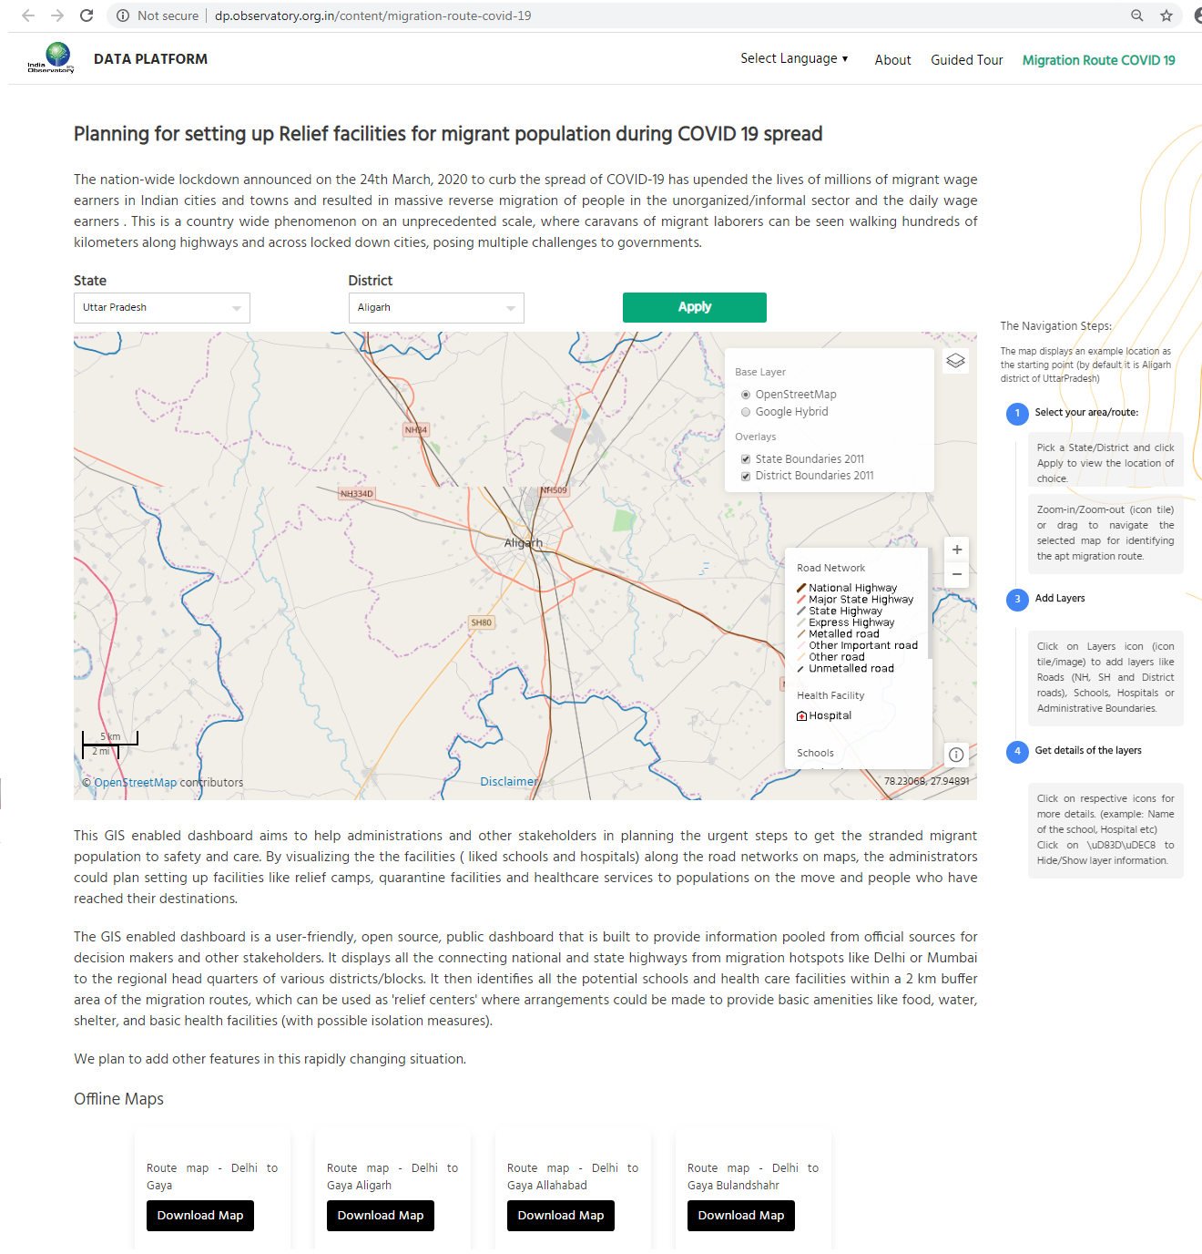
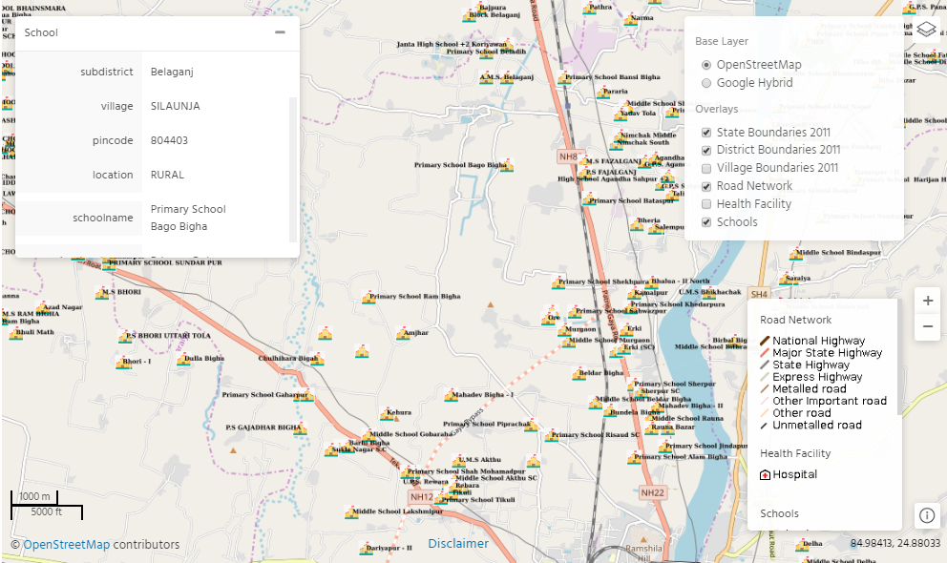
After selection of the school layer, all the schools
around 2km buffer of the road will be displayed
Move your cursor on the school and a pop up will
be opened and user can see the details of that particular school

Slide 8
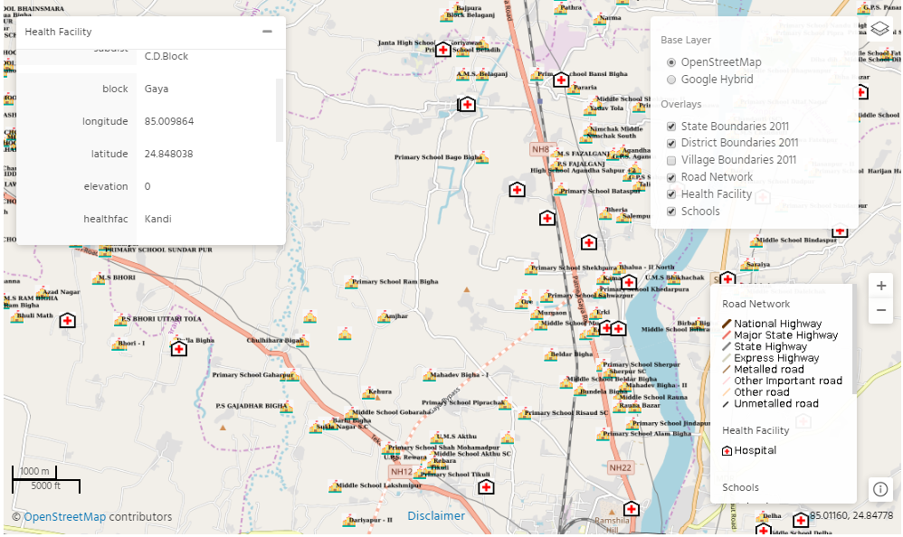
After Selection of the hospital layer, all the existing health facility
around 2km buffer of the road will be displayed
Move your cursor on the “+” and a pop up will
be opened and user can see the details of that particular health facility

Slide 9
User can download the offline Maps (district wise) –
presently the maps are available for all the district from Delhi to Gaya route

Slide 10
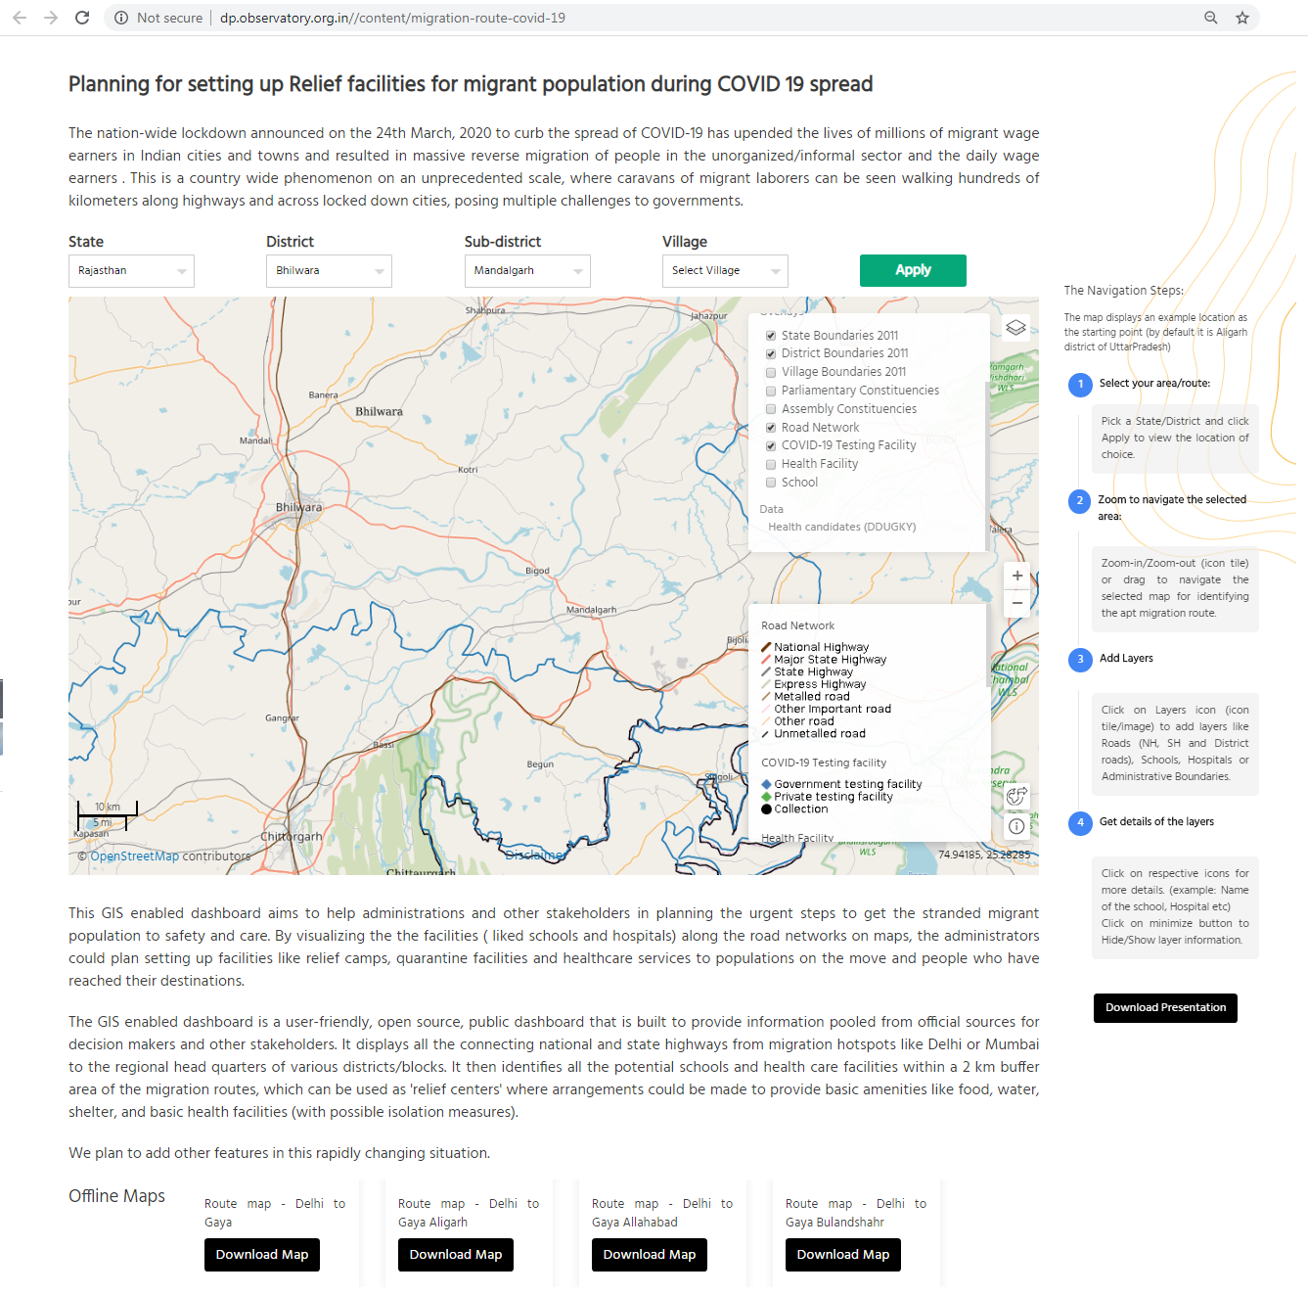
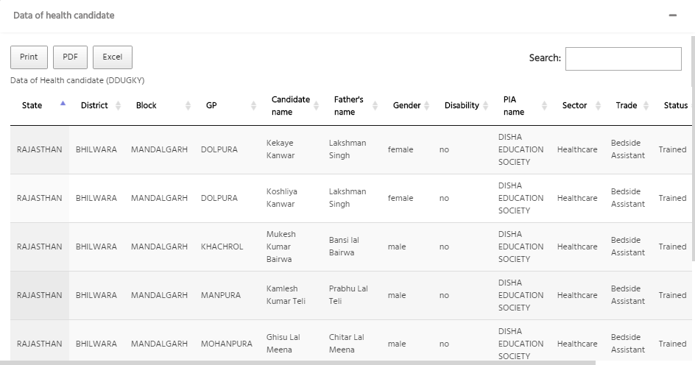
Click here to get the trained health
worker data in your selected block/tehsil

Slide 11
Thanks
For any support and feedback please write to us:
chiranjit@fes.org.in
jay@fes.org.in
ashok@fes.org.in

